Slide 1
CPU Scheduling
تقسيم وقت المعالج على العمليات النشطة فى الـ (Ready Queue)
Dr: Ahmed Saleh
Teacher of computer – Faculty of Engineering – Mansoura aisaleh@yahoo.com

Slide 2

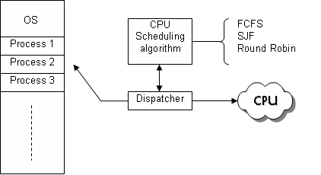

Q: Explain what is meant by CPU scheduling, and then discuss the difference between loader and dispatcher?
Sol:
Difference between loader and dispatcher:
Ready Queue
Process need to be executed

Slide 3
CPU scheduling
CPU Scheduling is the method to select a process from the ready queue to be executed by CPU when ever the CPU becomes idle.
Some Examples:
  First Come First Serviced (FCFS) scheduling.
  Shortest Job First (SJF) scheduling.
  Priority scheduling.
FCFS
SJF
CPU Scheduling Algorithm
Priority
Process 1
Ready Queue
Process 2
?
Dispatcher
CPU
Process 3
Memory

Slide 4
Q: Explain the main differences between preemptive and non preemptive scheduling?
Sol:
Preemptive scheduling: allows releasing the current executing process from CPU when another process (which has a higher priority) comes and need execution.
Non-preemptive scheduling: once the CPU has been allocated to a process, the process keeps the CPU until it release the CPU .

Slide 5
Preemptive Scheduling
CPU
Non- Preemptive Scheduling
CPU

Slide 6
Q: discuss in details, what is meant by the following parameters:
    CPU utilization.
    System throughput.
    Turnaround time.
    Waiting time.
    Response time.
Then discuss which parameter to maximize and which one to minimize?

Slide 7
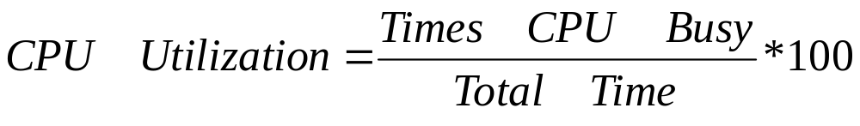
Sol:
CPU Utilization:
The percentage of times while CPU is busy to the total time ( times CPU busy + times it is idle). Hence, it measures the benefits from CPU.
To maximize utilization, keep CPU as busy as possible.
CPU utilization range from 40% (for lightly loaded systems) to 90% (for heavily loaded) (Explain why? CPU utilization can not reach 100%, because of the context switch between active processes).

Slide 8
System Throughput:
The number of process that are completed per time unit (hour)
Turnaround time:
For a particular process, it is the total time needed for process execution (from the time of submission to the time of completion).
It is the sum of process execution time and its waiting times (to get memory, perform I/O, ….).
Waiting time:
The waiting time for a specific process is the sum of all periods it spends waiting in the ready queue.
Response time.
It is the time from the submission of a process until the first response is produced (the time the process takes to start responding).

Slide 9
It is desirable to:
Maximize:
  CPU utilization.
  System throughput.
Minimize:
  Turnaround time.
  Waiting time.
  Response time.

Slide 10


First Come First Serviced (FCFS) algorithm
  The process that comes first will be executed first.
  Not preemptive.
Ready queue
FCFS Scheduling
CPU

Slide 11
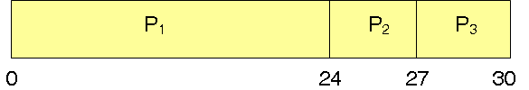
Consider the following set of processes, with the length of the CPU burst (Execution) time given in milliseconds:
The processes arrive in the order
P1, P2, P3. All at time 0.
Gant chart:
waiting times and turnaround times for each process are:
Hence, average waiting time= (0+24+27)/3=17 milliseconds
Process | Burst Time
P1 | 24
P2 | 3
P3 | 3
1
2
3
Process | P1 | P2 | P3
Waiting Time (WT) | 0 | 24 | 27
Turnaround Time (TAT) | 24 | 27 | 30
+
Execution Time

Slide 12
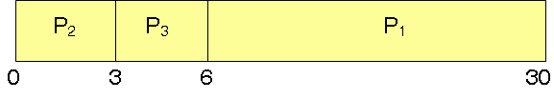
Repeat the previous example, assuming that the processes arrive in the order P2, P3, P1. All at time 0.
Gant chart:
waiting times and turnaround times for each process are:
Hence, average waiting time= (6+0+3)/3=3 milliseconds
Process | Burst Time
P1 | 24
P2 | 3
P3 | 3
3
1
2
Process | P1 | P2 | P3
Waiting Time (WT) | 6 | 0 | 3
Turnaround Time (TAT) | 30 | 3 | 6

Slide 13
Q: Explain why? FCFS CPU scheduling algorithm introduces a long average waiting time?
Sol:
Because:
it suffers from Convoy effect, hence, all other processes must wait for the big process to execute if this big process comes first.
This results in a long waiting time for small processes, and accordingly increases the average waiting time.

Slide 14
Shortest-Job-First (SJF) scheduling
When CPU is available, it will be assigned to the process with the smallest CPU burst (non preemptive).
If two processes have the same next CPU burst, FCFS is used.
SJF Scheduling
X
10
5
18
7
18
10
7
5
CPU
Note: numbers indicates the process execution time

Slide 15
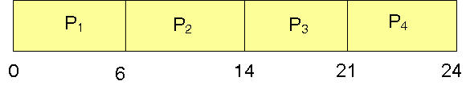
Consider the following set of processes, with the length of the CPU burst time given in milliseconds:
The processes arrive in the order
P1, P2, P3, P4. All at time 0.
1. Using FCFS
Gant chart:
waiting times and turnaround times for each process are:
Hence, average waiting time= (0+6+14+21)/4=10.25 milliseconds
Process | Burst Time
P1 | 6
P2 | 8
P3 | 7
P4 | 3
Process | P1 | P2 | P3 | P4
Waiting Time (WT) | 0 | 6 | 14 | 21
Turnaround Time (TAT) | 6 | 14 | 21 | 24

Slide 16

2. Using SJF
Gant chart:
waiting times and turnaround times for each process are:
Hence, average waiting time= (3+16+9+0)/4=7 milliseconds
Process | Burst Time
P1 | 6
P2 | 8
P3 | 7
P4 | 3
Process | P1 | P2 | P3 | P4
Waiting Time (WT) | 3 | 16 | 9 | 0
Turnaround Time (TAT) | 9 | 24 | 16 | 3

Slide 17
Q: Explain why? SJF CPU scheduling algorithm introduces the minimum average waiting time for a set of processes? Give an example.
Sol:
Because: by moving a short process before a long one, the waiting time of the short process decreases more than it increases the waiting time of the long process. Hence, the average waiting time decreases.
Example: assuming two processes P1 and P2
Process | Burst Time
P1 | 30
P2 | 2
Using FCFS
Using SJF
P1
P2
P2
P1
0
30
32
0
2
32
Waiting time(P1)=0
Waiting time(P2)=30
Average waiting time=(0+30)/2=15
Waiting time(P1)=2
Waiting time(P2)=0
Average waiting time=(0+2)/2=1

Slide 18
Shortest-Remaining-Time-First (SRTF)
  It is a preemptive version of the Shortest Job First .
  It allows a new process to gain the processor if its execution time less than the remaining time of the currently processing one.
SRTF Scheduling
2
10
7
5
4
3
CPU

Slide 19
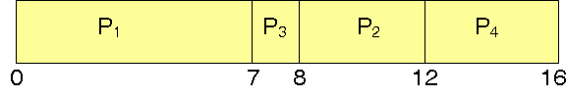
Consider the following set of processes, with the length of the CPU burst time given in milliseconds:
The processes arrive in the order
P1, P2, P3, P4. as shown in table.
1. Using SJF
Gant chart:
waiting times and turnaround times for each process are:
Hence, average waiting time= (0+6+3+7)/4=4 milliseconds
Process | Burst Time | Arrival Time
P1 | 7 | 0
P2 | 4 | 2
P3 | 1 | 4
P4 | 4 | 5
Process | P1 | P2 | P3 | P4
Waiting Time (WT) | 0 | 6 | 3 | 7
Turnaround Time (TAT) | 7 | 10 | 4 | 11

Slide 20
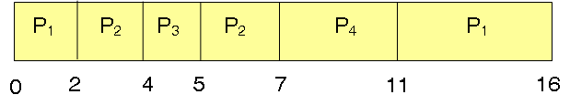
2. Using SRTF
Gant chart:
waiting times and turnaround times for each process are:
Hence, average waiting time= (9+1+0+2)/4=3 milliseconds
Process | Burst Time | Arrival Time
P1 | 7 | 0
P2 | 4 | 2
P3 | 1 | 4
P4 | 4 | 5
Process | P1 | P2 | P3 | P4
Waiting Time (WT) | 9 | 1 | 0 | 2
Turnaround Time (TAT) | 16 | 5 | 1 | 6

Slide 21
Priority scheduling
A priority number (integer) is associated with each process
The CPU is allocated to the process with the highest priority (smallest integer). There are two types:
  Preemptive
  nonpreemptive
Priority Scheduling
X
10
5
18
7
18
10
7
5
CPU
Note: numbers indicates the process priority

Slide 22
Problems with Priority scheduling
Problem ≡ Starvation (infinite blocking)– low priority processes may never execute
Solution ≡ Aging – as time progresses increase the priority of the process
Very low priority process
Very low priority process
Very low priority process
28
26
8
8
30
5
4
2
Starvation
Aging

Slide 23
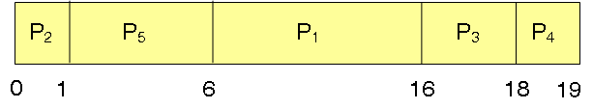
Consider the following set of processes, with the length of the CPU burst time given in milliseconds:
The processes arrive in the order
P1, P2, P3, P4, P5. All at time 0.
1. Using priority scheduling
Gant chart:
waiting times and turnaround times for each process are:
Hence, average waiting time= (6+0+16+18+1)/5=8.2 milliseconds
Process | Burst Time | priority
P1 | 10 | 3
P2 | 1 | 1
P3 | 2 | 4
P4 | 1 | 5
P5 | 5 | 2
Process | P1 | P2 | P3 | P4 | P5
Waiting Time (WT) | 6 | 0 | 16 | 18 | 1
Turnaround Time (TAT) | 16 | 1 | 18 | 19 | 6
Note: preemptive scheduling ≡ non-preemptive as all processes arrives at time 0

Slide 24
Ex: Consider the following set of processes, with the length of the CPU burst time and arrival times given in milliseconds:
Process | Burst Time | priority | Arrival Time
P1 | 5 | 3 | 0
P2 | 9 | 4 | 2
P3 | 4 | 1 | 3
P4 | 2 | 2 | 5
P5 | 1 | 5 | 6
P6 | 8 | 2 | 8
Show how to schedule those processes using:
  Preemptive priority.
  Non-preemptive priority.

Slide 25
Round Robin scheduling
Allocate the CPU for one Quantum time (also called time slice) Q to each process in the ready queue.
This scheme is repeated until all processes are finished.
A new process is added to the end of the ready queue.
Round Roben Scheduling
Q
Q
Q
Q
Q
Q
Q
Q
Q
Q
Q
Q
Q
Q
Q
Q
CPU
CPU
CPU
CPU

Slide 26
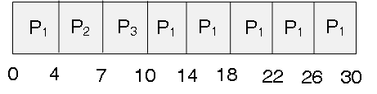
Consider the following set of processes, with the length of the CPU burst time given in milliseconds:
The processes arrive in the order
P1, P2, P3. All at time 0.
use RR scheduling with Q=2 and Q=4
RR with Q=4
Gant chart:
waiting times and turnaround times for each process are:
Hence, average waiting time= (6+4+7)/3=5.66 milliseconds
Process | Burst Time
P1 | 24
P2 | 3
P3 | 3
Process | P1 | P2 | P3
Waiting Time (WT) | 6 | 4 | 7
Turnaround Time (TAT) | 30 | 7 | 10

Slide 27
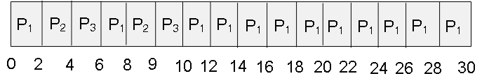
RR with Q=2
Gant chart:
waiting times and turnaround times for each process are:
Hence, average waiting time= (6+6+7)/3=6.33 milliseconds
Process | Burst Time
P1 | 24
P2 | 3
P3 | 3
Process | P1 | P2 | P3
Waiting Time (WT) | 6 | 6 | 7
Turnaround Time (TAT) | 30 | 9 | 10

Slide 28
Explain why? If the quantum time decrease, this will slow down the execution of the processes.
Sol:
Because decreasing the quantum time will increase the context switch (the time needed by the processor to switch between the processes in the ready queue) which will increase the time needed to finish the execution of the active processes, hence, this slow down the system.

Slide 29
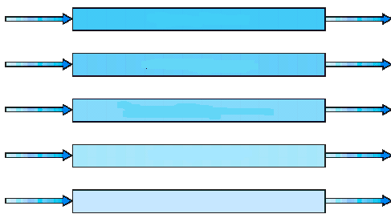
Multi-level queuing scheduling
There are two types:
  Without feedback: processes can not move between queues.
  With feedback: processes can move between queues.
Multi-level queuing without feedback:
Divide ready queue into several queues.
Each queue has specific priority and its own scheduling algorithm (FCFS, …).
High priority Queue
CPU
Low priority Queue

Slide 30

Multi-level queuing with feedback:
Divide ready queue into several queues.
Each queue has specific Quantum time as shown in figure.
Allow processes to move between queues.
Queue 0
Queue 1
Queue 2

Slide 31
  In multi-level Queuing Scheduling with feedback, using 3 queues with the corresponding quantum times shown in the following figure. Show how to execute the following processes;
Process | Burst Time | Arrival Time
P1 | 10 | 0
P2 | 26 | 5
P3 | 7 | 12
Queue 0
Queue 1
Queue 2

Slide 32
Solution
Time | Available Processes | Allocated Process
0 | P1(10) at Q1 | P1
8 | P2(26) at Q1 P1(2) at Q2 | P2
16 | P3(7) at Q1 P1(2) at Q2 P2(18) at Q2 | P3
23 | P1(2) at Q2 P2(18) at Q2 | P1
25 | P2(18) at Q2 | P2
41 | P2(2) at Q3 | P2
43 | Finished
Execution Sequence: P1, P2, P3, P1, P2, P2

Slide 33
  Repeat the previous example assuming P3 arrives at time 22.
Process | Burst Time | Arrival Time
P1 | 10 | 0
P2 | 26 | 5
P3 | 7 | 22
Queue 0
Queue 1
Queue 2

Slide 34
  In multi-level Queuing Scheduling with feedback, using 3 queues Q1, Q2, and Q3 with the corresponding quantum times 10, 20, FCFS respectively. Show how to execute the following processes;
Process | Burst Time | Arrival Time
P1 | 12 | 0
P2 | 25 | 8
P3 | 33 | 21
P4 | 2 | 30
P5 | 8 | 37
P6 | 40 | 41

Slide 35

Any Questions?

